Slide 1
Welcome to the Cell.
The beginning of Microbiology

Slide 2
Warm-Up
Place your syllabus on the edge of your table so I can collect them.
What is a prokaryotic cell?
What is a Eukaryotic cell?
List three differences between these two types of cells.

Slide 3
What your goal is today
Today we are going to be discussing the main differences between Prokaryotes and Eukaryotes.
Your job is to use the book to find differences between the cells.
We will do viruses together after the other cells.

Slide 4
Prokaryote, Eukaryote, & Viruses
Prokaryote | Eukaryote | Virus

Slide 5
Place these statements in the correct column (some may go in more than one column)
Bacteria
Animals & plants
contain ribosomes
Contain nucleic acids (DNA or RNA)
have a nucleus
No nucleus
have membrane-bound organelles
do not have membrane-bound Organelles
multicellular organisms
unicellular organisms
Capsid surrounds the genetic material
cell
Not a cell
Cannot reproduce by themselves
Too small to be seen with light microscope

Slide 6
Warm Up
Name two ways you can tell a prokaryotic cell from a eukaryotic cell.
With your neighbor, discuss the differences between the cells and why you think those differences exist.

Slide 7
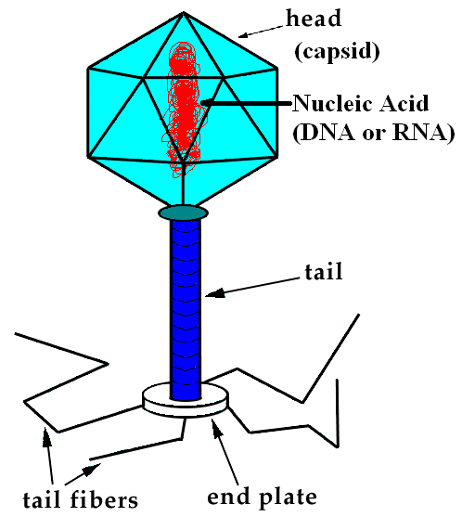
Virus
Too small to be seen with light microscope
Capsid surrounds the genetic material
Contain nucleic acids
(DNA or RNA)
No nucleus
Do NOT have membrane-bound Organelles
Not a cell
Cannot reproduce by themselves

Slide 8
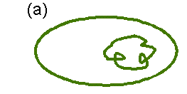
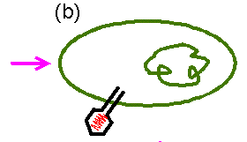
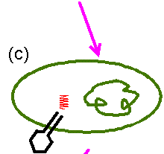
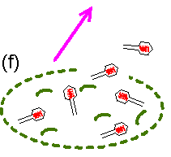
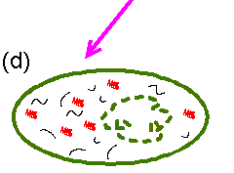
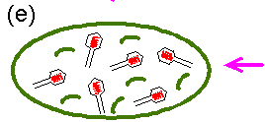
Viruses cannot reproduce by themselves
Bacteria
Virus

Slide 9
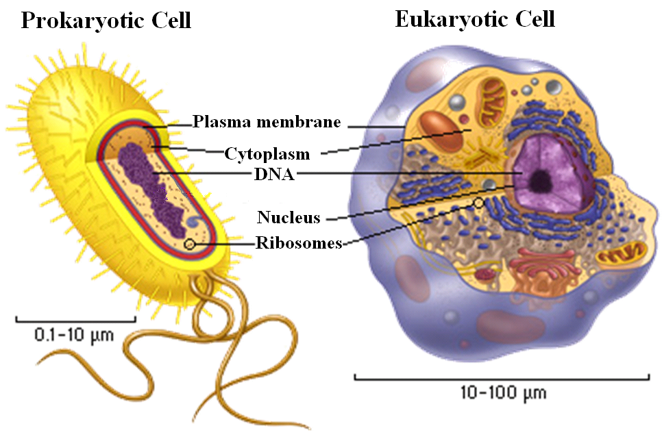
Comparison of Prokaryotic and Eukaryotic Cells

Slide 10
Prokaryote, Eukaryote, & Viruses
Page 470 Pro & 1 Eu
Page 470 1 Virus
Prokaryote | Eukaryote | Virus
bacteria | Animals & plants | Contain nucleic acids (DNA or RNA)
contain ribosomes | contain ribosomes | No nucleus
Contain nucleic acids (DNA or RNA) | Contain nucleic acids (DNA or RNA) | Capsid surrounds the genetic material
No nucleus | have a nucleus | do not have membrane- bound Organelle
unicellular organisms | Have membrane-bound organelles | Cannot reproduce by themselves
do not have membrane- bound Organelle | multicellular organisms | Too small to be seen with light microscope
Cell | Unicellular organisms | Not a cell
 | cell

Slide 11
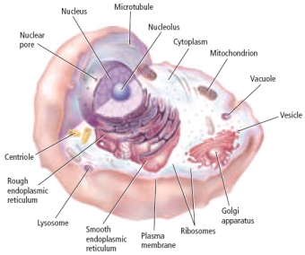
Virus
Capsid surrounds the genetic material
Cannot reproduce by themselves
Not a cell
Too small to be seen with light microscope
No nucleus
Prokaryotic
No membrane-bound organelles
Eukaryotic
Bacteria
Contain
DNA & RNA
Have nucleus
Have membrane-bound organelles
Unicellular organisms
Cell
Contain ribosomes
Multicellular organisms
Animals & plants

