Slide 1
DNA Structure and Replication Notes
February 5, 2015

Slide 2
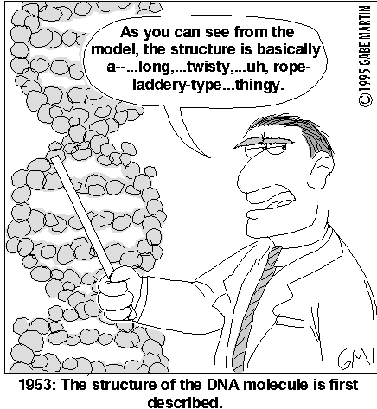
DNA Structure Notes

Slide 3
I. Functions of DNA = “Blueprint of Life”
Storing Information
Store the genes that code for basic instructions for cells and cell parts, physical traits, diseases, etc.
Eye color, blood type, skin color, diabetes, etc.
Copying Information
Before a cell divides, it must make a copy of every one of its genes
Process called DNA replication
Transmitting Information
Genes are transmitted from one generation to the next
DNA must be carefully sorted and passed along during mitosis and meiosis

Slide 4
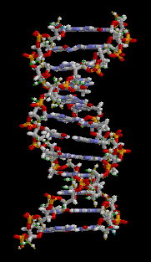
II. Basics of DNA Structure
DNA - stands for deoxyribonucleic acid
B. double-stranded
C. 3-D model is called = double helix
Discovered by James Watson & Francis Crick (Received Nobel Prize 1962) with the help of Rosalind Franklin’s data

Slide 5
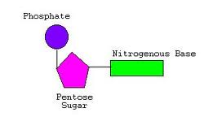
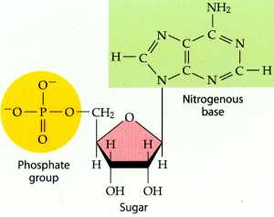
III. Nucleic Acid Structure
DNA is a type of molecule called a nucleic acid
The building blocks of DNA are known as nucleotides
All nucleotides have three “parts” in common:
Phosphate
Sugar (deoxyribose)
Nitrogen base

Slide 6
NUCLEOTIDE

Slide 7
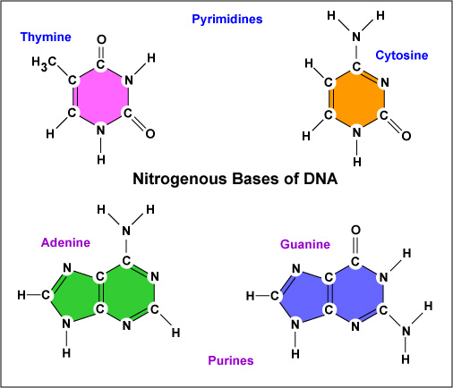
B. Nitrogen Bases
Four types:
Adenine
Guanine
Cytosine
Thymine
2. The order of these bases = the genetic code!

Slide 8
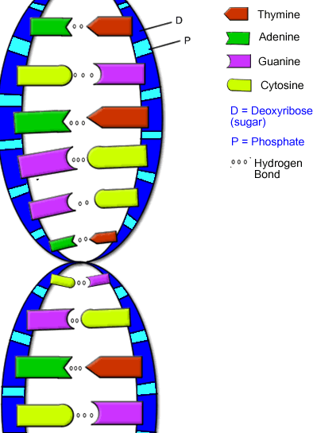
Complementary Base Pairing
A-T and C-G pairs are the only ones physically possible
Hydrogen bonds between nitrogen bases
2. Adenine and Thymine must form two hydrogen bonds to be stable while Guanine and Cytosine must form three hydrogen bonds

Slide 9
LET’S PRACTICE!
Write the complementary sequence of bases to this strand of DNA.
A T C C G G A T

Slide 10
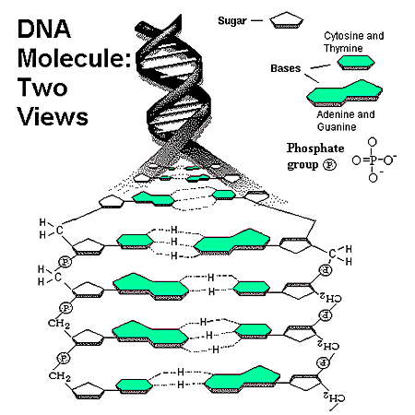
DNA Structure (more details)
Sugar/Phosphate “Backbone”
Sides of ladder
Covalent bond between
sugar and phosphate
Nitrogen Bases in center
Steps of ladder
Hydrogen bond between
Nitrogen bases
Double Helix
Twisted ladder
Anti-parallel
two strands of DNA run
in opposite directions

Slide 11
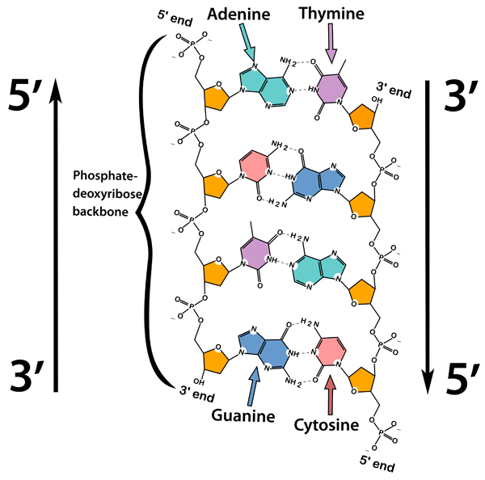
DNA is Anti-Parallel
The two strands
of DNA run in
opposite directions
This allows for the
bases to come in contact at the center of the molecule

Slide 12
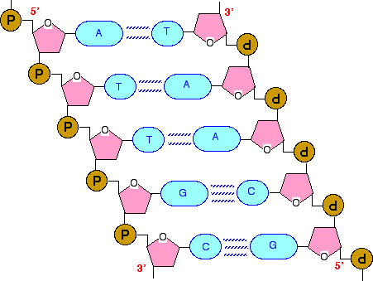

Slide 13
DNA Replication Notes
February 5, 2015

Slide 14
I. DNA Replication
Purpose
All cells must divide to make new cells
Before cell division DNA is replicated so it can be passed to the new cell
This process of copying the DNA in the chromosomes is called DNA Replication
Without this process, new cells would have only half the DNA of their parents

Slide 15
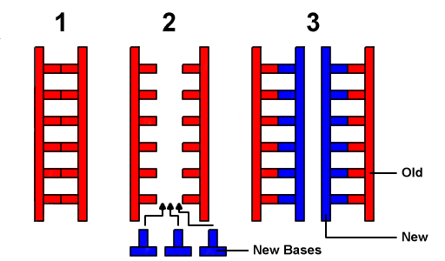
B. Process of DNA Replication
Occurs in the nucleus prior to any cell division
Enzyme, helicase, is used to “unzip” or “unwind” the DNA into two single strands
Helicase breaks hydrogen bonds between nitrogen bases
This occurs along several sections of the whole molecule of DNA
Enzyme

Slide 16
B. Process of DNA Replication (cont.)
Another enzyme, DNA polymerase, bonds a complementary nucleotide to each strand of template DNA
Nitrogenous bases pair up
A – T
C - G
Each strand is replicated in opposite directions, since DNA is anti-parallel
Process continues until the entire strand of DNA has been unzipped and replicated

Slide 17
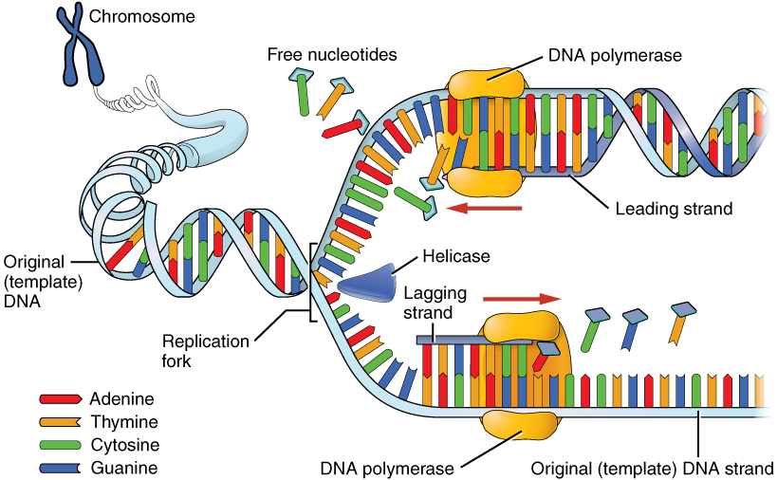

Slide 18
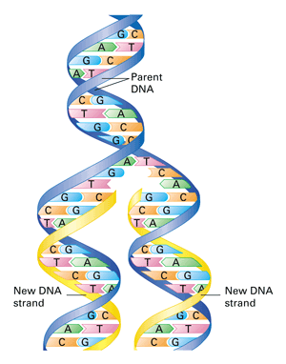
B. Process of DNA Replication (cont.)
As a result, you create two new molecules of DNA that are identical to the original piece of parent DNA
Each DNA molecule has a new strand of DNA and an old strand of DNA (parent DNA)

