Slide 1
An introduction to CRISPR gene engineering

Slide 2
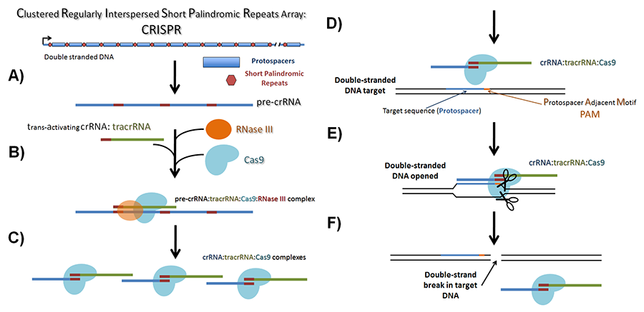
Introduction to CRISPR
http://www.addgene.org/CRISPR/guide/

Slide 3
Wiedenheft et al. Nature 2012

Slide 4
3 distinct types of bacterial CRISPR systems identified so far:
Type I, II, III
Type II is the basis for current genome engineering applications
From Streptococcus pyogenes
The S. pyogenes system is orthogonal to the native E. coli system
Jinek et al., Science 2012
Notes:
More than one type of CRISPR types can be found in a single organism, indicating mutual compatibility

Slide 5
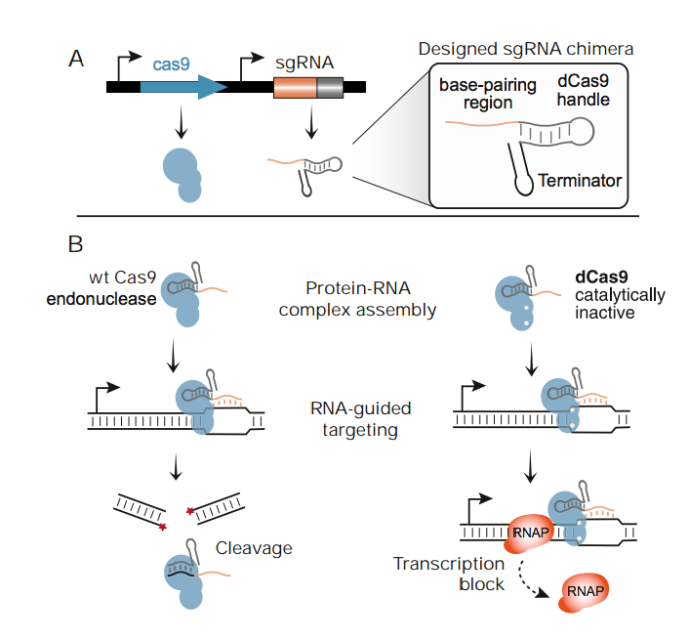
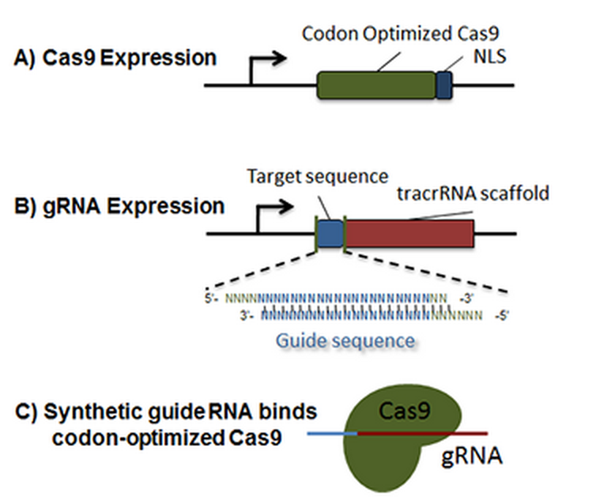
Genomic manipulation requires only :
the Cas9 protein and
an engineered small guide RNA (sgRNA) with a PAM sequence upstream of target complementary sequence
Contains a designed hairpin to mimic the CRISPR RNA and trans-acting RNA complex
Base-pairing between the sgRNA and target DNA causes double-strand breaks due to the endonuclease activity of Cas9
http://www.addgene.org/CRISPR/guide/
Qi et al. Cell 2013

Slide 6
DNA target does not need to be unique and can appear in multiple locations, all of which will be targeted by the Cas9 nuclease for cleavage
can be on a plasmid or integrated into the bacterial genome.
The sgRNA can bind on either strand of DNA and the Cas9 will cleave both strands (double strand break, DSB). The DSB results in the silencing of that DNA sequence.
Changing the target specificity of the RNA-protein complex does not require protein engineering but only the design of the short crRNA guide
Directing the specificity of dual-RNA:Cas9 with several different crRNAs allows for the introduction of multiple mutations at the same time.
Jiang et al. Nature Biotech, 2013

Slide 7
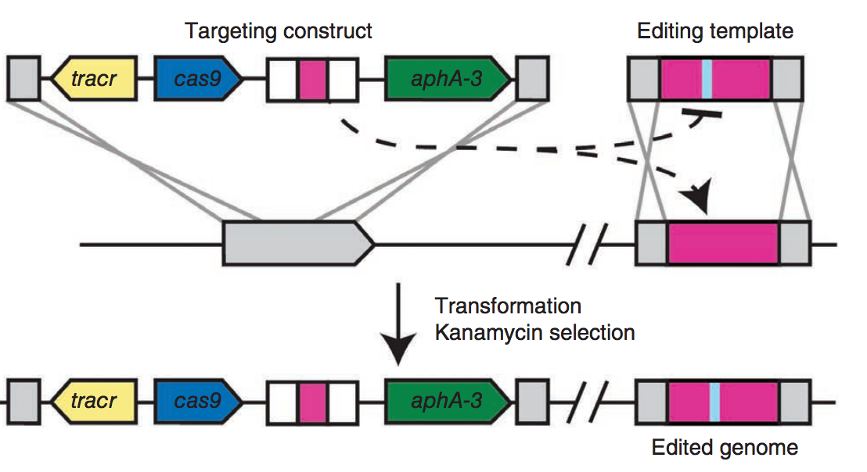
The CRISPR targeting construct directs cleavage of a chromosomal locus and is co-transformed with an editing template that recombines with the target to prevent cleavage. Kanamycin-resistant transformants that survive CRISPR attack contain modifications introduced by the editing template. tracr, trans-activating CRISPR RNA; aphA-3, kanamycin resistance gene.
Jiang et al. Nature Biotech 2013

Slide 8
CRISPRi (CRISPR interference)
Repurposed for genome regulation rather than gene editing
Catalytically inactive version of Cas9 (no endonucleolytic activity)
Modified transcription without genetic alteration of the target gene sequence
sgRNA comprises 3 segments:
20-nt sequence complementary to target
42-nt Cas9-binding hairpin (Cas9 handle)
40-nt transcription terminator
Larson et al., Nature protocols 2013
Qi et al., Cell 2013
Notes:
Guiding RNA shown targets the nontemplate DNA strand of the mRFP-coding region

Slide 9
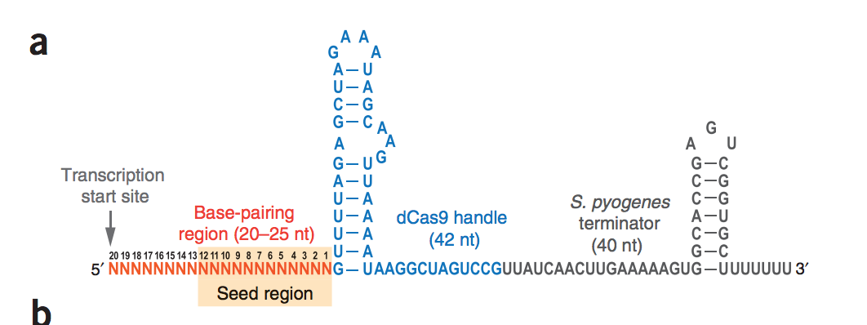
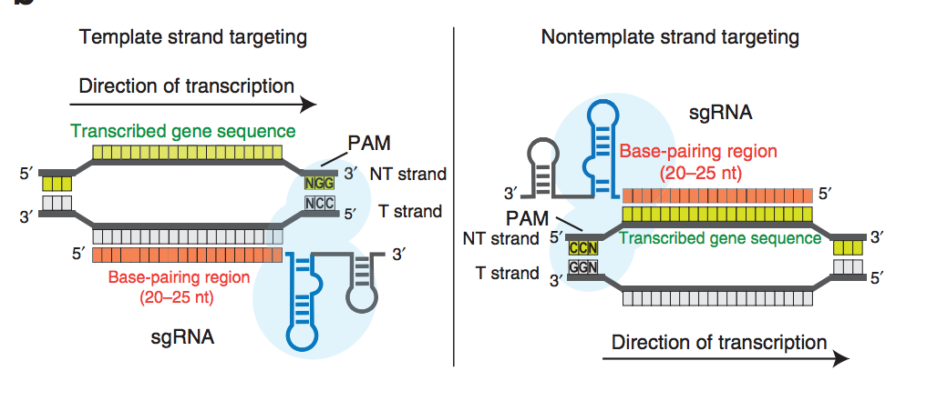

Slide 10
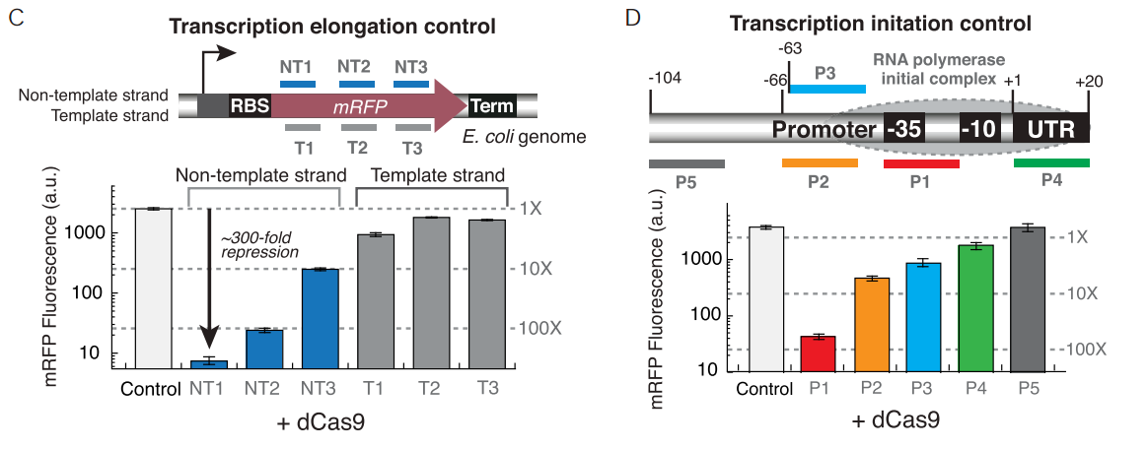
Location of target sequence matters

Slide 11
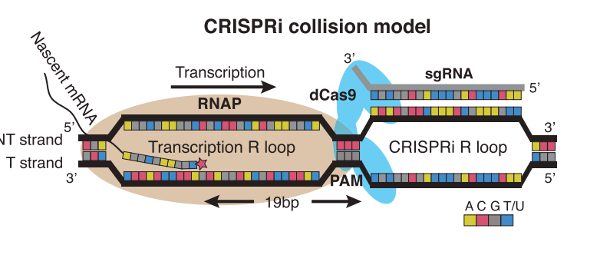
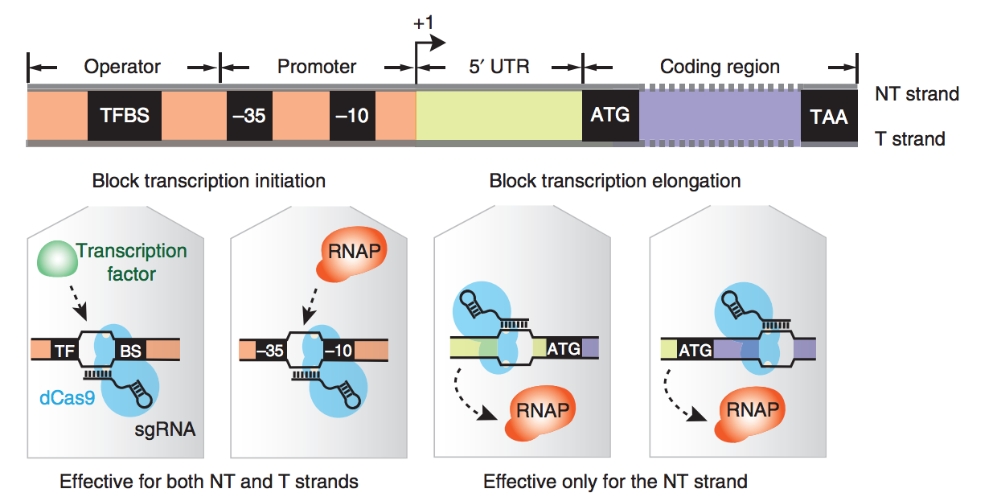
CRISPRi functions by blocking transcription through physical obstruction of RNA polymerase
*Different from RNAi-based silencing, which requires the destruction of already transcribed mRNA
Notes:
Non-template DNA strand shares the same sequence identity as transcribed mRNA, and only sgRNAs binding to the non-template DNA strand exhibited silencing.
Directly blocks transcription by physical collision with RNA polymerase.

Slide 12
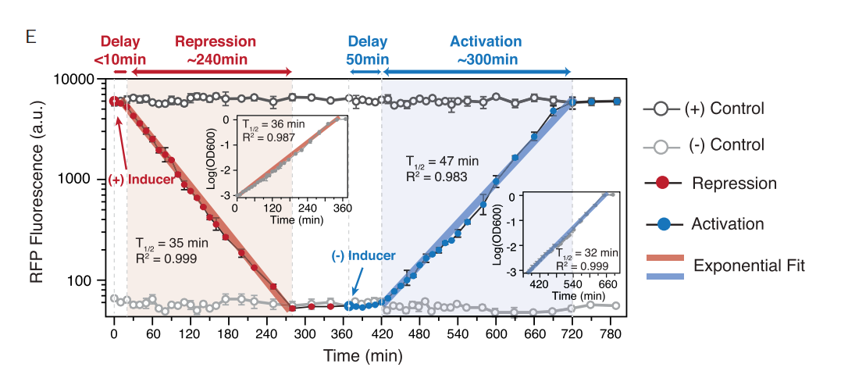
Repression effect is inducible and reversible
An aTc-inducible promoter was used in this case.
Notes:
Inducer removed by washing
50min delay lightly determined by the dCas9/sgRNA turnover rate offset by dilution by cell growth and division

Slide 13
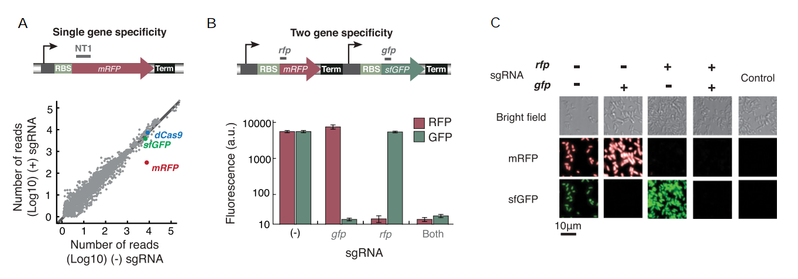
High specificity and can simultaneously regulate multiple genes

Slide 14
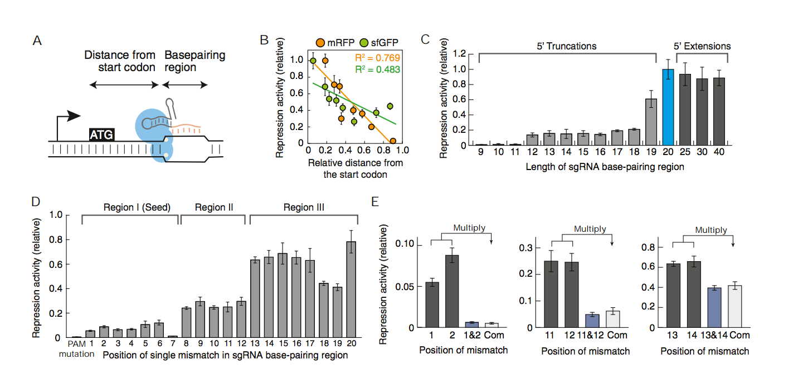
Specificity is determined by the PAM region (2bp) and at least a 12bp sgRNA stretch (from 5’end)
Notes:
PAM mutation completely abolished repression ability.
There is a seed region that is important for binding, within the first 7nt.
Multiplicative effect of double mutation suggests an independent relationship between mismatches.
12bp is sufficient to cover most bacterial genomes for unique target sites

Slide 15
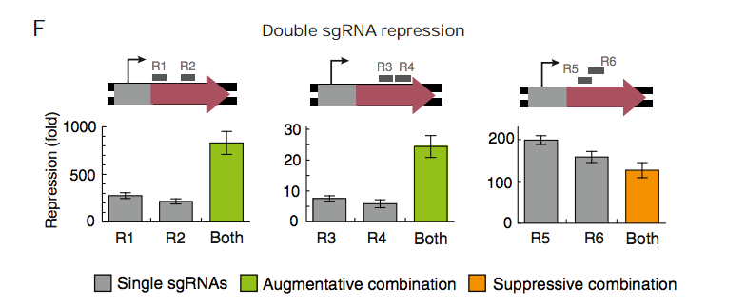
Repression efficiency can be enhanced by combining non-overlapping sgRNAs targeted against the same gene

Slide 16
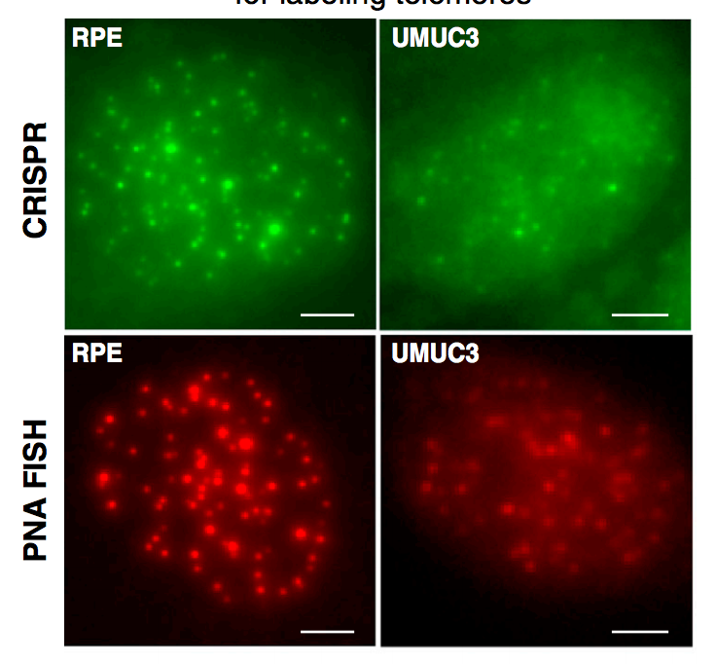
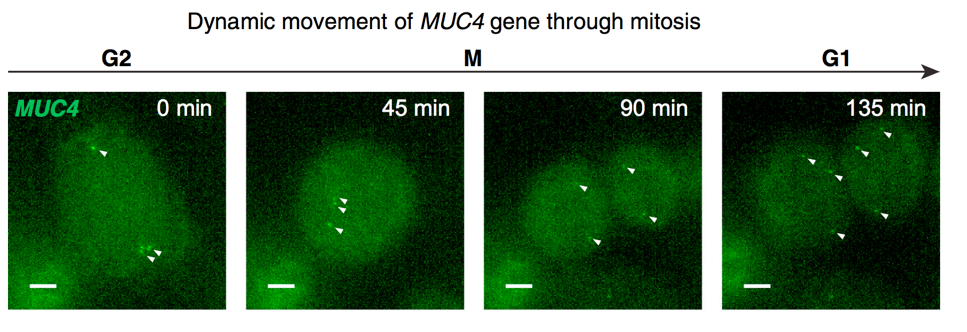
Imaging genomic loci in living human cells
Chen et al. Cell 2013

Slide 17
Can be used to:
Efficiently and selectively repress transcription of target genes
Target large numbers of genes to infer gene function, or map genetic interactions through gene pairs
Probe regulatory functions (activating / repressing / neutral) of genes and cis elements in a complex regulatory network
Manipulate microbial genomes, esp. nonmodel organisms with limited genetic tools developed
Image genomic loci in living cells
Limitations:
The requirement for the NGG PAM sequence for Cas9 limits the availability of target sites
Though other Cas9 homologs may use different PAM sequences
S. pyogenes Cas9 could partially recognize an NAG PAM sequence
Some target sequences may be problematic due to the RNA secondary structure that may form

Slide 18
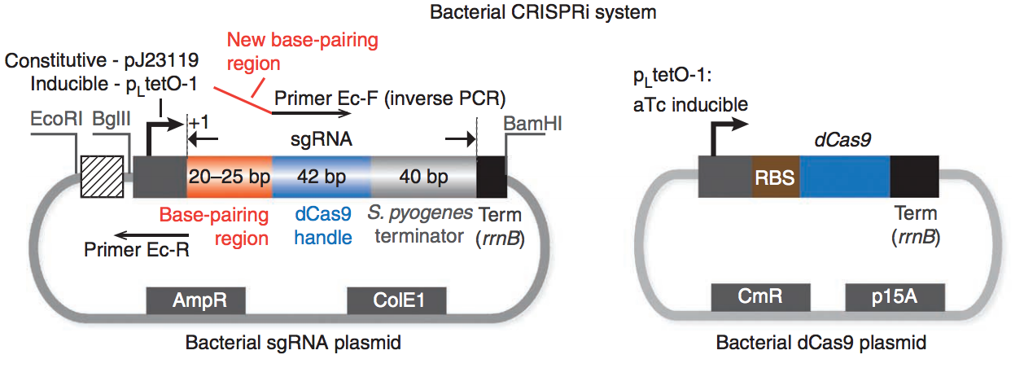
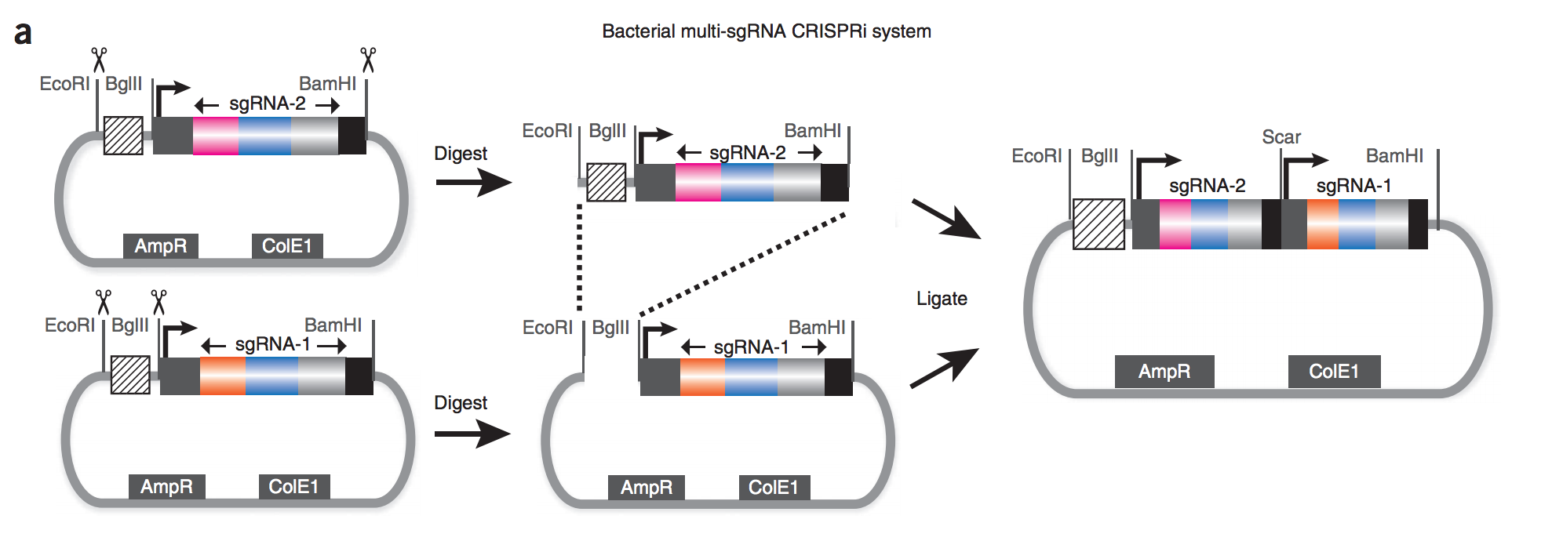
Larson et al., Nature protocols 2013

Slide 19
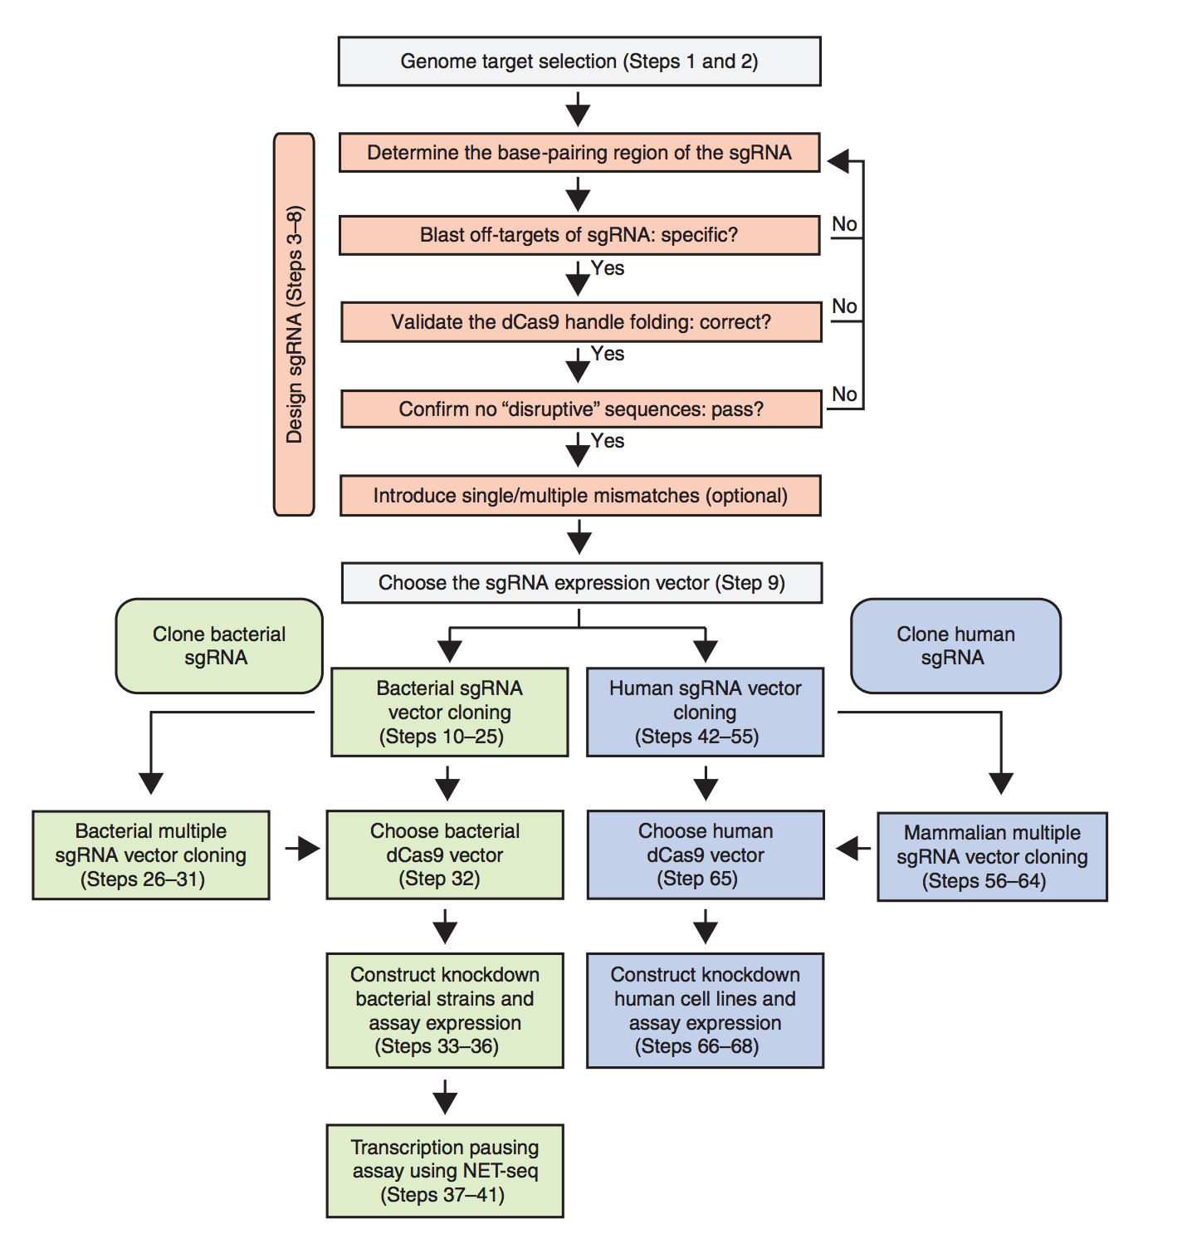
Can measure effects on transcription using qRT-PCR or genome-wide NET-seq.
Can also check for effects on protein expression if the target gene was fused to a fluorescent protein / lacZ
Larson et al., Nature protocols 2013

Slide 20
Designing / making plasmids
http://www.addgene.org/crispr/marraffini/
http://www.addgene.org/crispr/church/

Slide 21
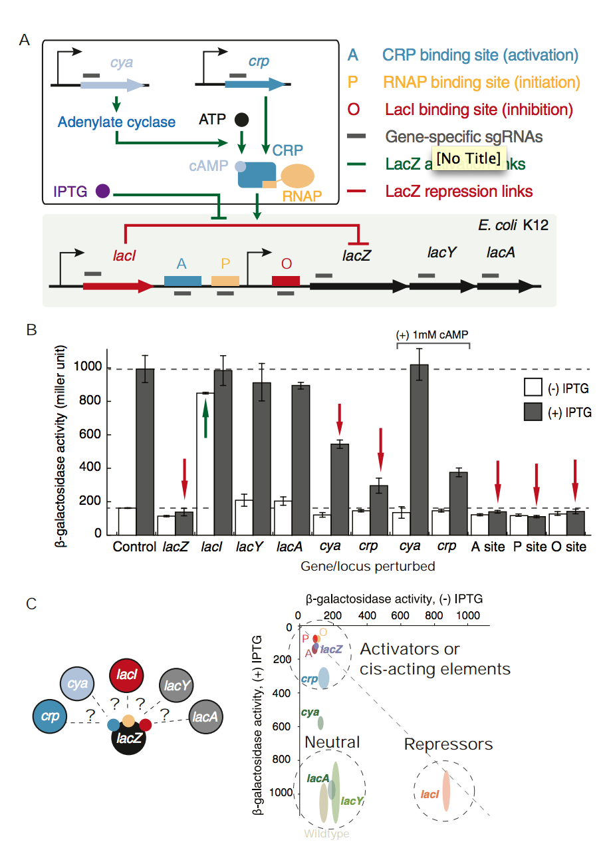
Inferring players in a signal tranduction network
Qi et al., Cell 2013
Notes:
IPTG inhibits lac repressor LacI, to induce lacZ expression.
lacZ-specific sgRNA presses laxZ expression, while lacI sgRNA activates LacZ expression even in the absence of IPTG.
cAMP-CRP is an activator by binding to a cis regulatory site upstream of the promoter. sgRNA targeted att he crp gene led to repression, demonstrating a means to link a regulator to its cis-regulatory sequence.

Slide 22
References
RNA-guided genetic silencing systems in bacteria and archaea. Blake Wiedenheft, Samuel H. Sternberg & Jennifer A. Doudna. Nature 2012
Multiplex Genome Engineering Using CRISPR/Cas Systems. Le Cong et al. Science 2013.
Orthogonal Cas9 proteins for RNA-guided gene regulation and editing. Esvelt et al. Nature Methods 2013
A Programmable Dual-RNA–Guided DNA Endonuclease in Adaptive Bacterial Immunity. Jinek et al. Science 2012
RNA-guided editing of bacterial genomes using CRISPR-Cas systems. Jiang et al. Nature Biotech 2013
Dynamic Imaging of Genomic Loci in Living Human Cells by an Optimized CRISPR/Cas System. Chen et al. Cell 2013
CRISPR interference (CRISPRi) for sequence-specific control of gene expression. Larson et al., Nature protocols 2013
Repurposing CRISPR as an RNA-Guided Platform for Sequence-Specific Control of Gene Expression. Qi et al., Cell 2013

