Slide 1
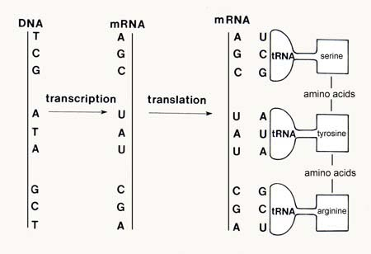
Protein Synthesis Notes

Slide 2
If DNA cannot leave the nucleus – How can it get the instructions out to make the proteins needed to survive??????
Genetic information (genes) coded in DNA provide all the information needed to assemble proteins.

Slide 3
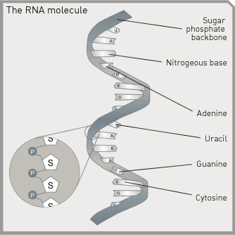
RNA
Contains the sugar ribose instead of deoxyribose.
Single-stranded instead of double stranded.
Contains uracil in place of thymine.

Slide 4
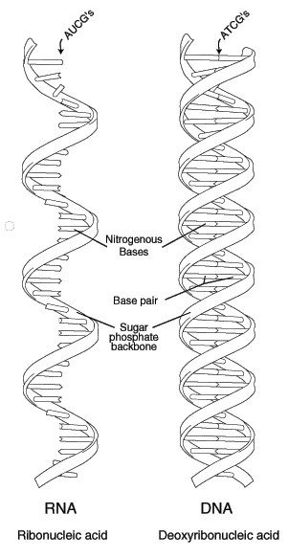
RNA Contains:
Adenine
Cytosine
Guanine
Uracil (not Thymine)

Slide 5
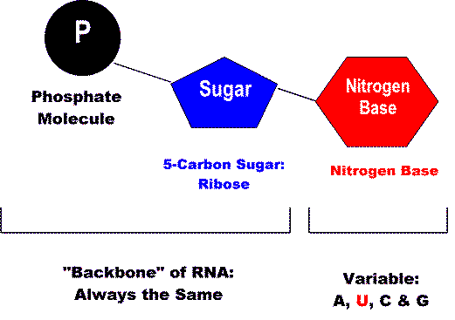
Comparison of DNA and RNA
DNA
3 Main differences between DNA & RNA
Sugar:
DNA: Deoxyribose
RNA: Ribose
Nitrogen Bases:
DNA: A, T, C, G
RNA: A, U, C, G
U = uracil
Number of strands that make up the molecule:
DNA: two strands
RNA: one strand
A, T, C, & G
RNA

Slide 6
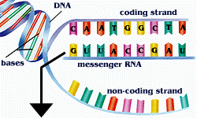
Three Main Types of RNA
Messenger RNA (mRNA) - Carries copies of instructions, for the assembly of amino acids into proteins, from DNA to the ribosome (serve as “messenger”)
* Made in the nucleus

Slide 7
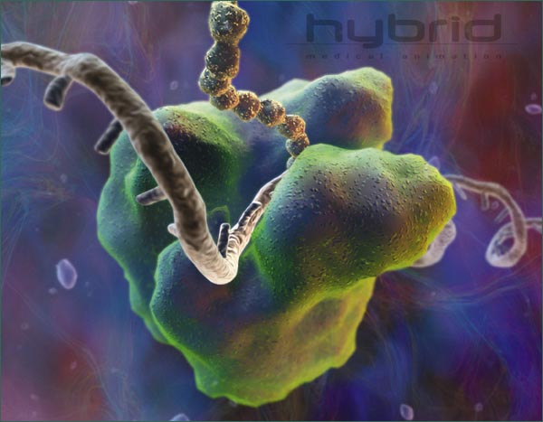
Three Main Types of RNA
2.Ribosomal RNA (rRNA) – Makes up the major part of ribosomes, which is where proteins are made.
* made in the nucleolus
1 ribosome = 4 molecules of rRNA and 82 proteins
Ribosomal RNA

Slide 8
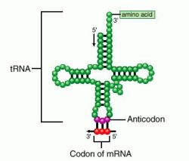
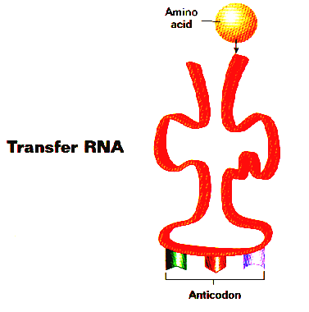
Three Main Types of RNA
Transfer RNA (tRNA) – Transfers (carries) amino acids to ribosomes as specified by codons in the mRNA

Slide 9
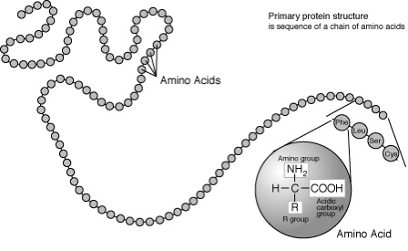
Proteins
Proteins are made up of a chain of amino acids.

Slide 10
2 Steps to Make a Protein
Transcription
DNA → RNA
Translation
RNA → Protein (Chain of amino acids)

Slide 11
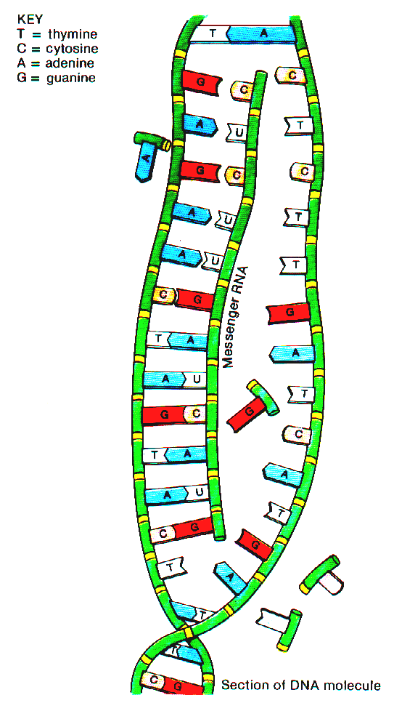
Step 1: Transcription
Transcription: a complementary single strand of mRNA is copied from part of the DNA in the nucleus
RNA Polymerase, an enzyme, unwinds DNA strand
RNA polymerase “reads” one strand of DNA bases and makes the RNA strand
If DNA is TACCAGTTT
mRNA will be AUGGUCAAA
c. mRNA leaves and DNA strands will coil back up

Slide 12
Step 1b: mRNA editing
mRNA editing: cutting and splicing mRNA before it leaves the nucleus
Introns- (intruders) “junk DNA” that doesn’t code for proteins are cut out
Exons- “good DNA” that code for proteins stay and are expressed
Introns are removed and exons are spliced together.
Edited mRNA is sent out of nucleus to ribosome
(the exons can be spliced together in different sequences to produce different mRNA’s = different proteins)
Notes:
over 98% of the human genome is noncoding DNA
We have 25,000 genes but produce more than 100,000 diff proteins = splicing

Slide 13
Fun FACT:
Over 98% of the human genome is noncoding DNA (introns)… Evolution perhaps?!?
We have 25,000 genes but produce more than 100,000 diff proteins = splicing

Slide 14
Transcription: DNA → RNA

Slide 15
Transcription Animation
http://www-class.unl.edu/biochem/gp2/m_biology/animation/gene/gene_a2.html
http://207.207.4.198/pub/flash/26/transmenu_s.swf (very good but need to skip some parts)
http://www.youtube.com/watch?v=983lhh20rGY

Slide 16
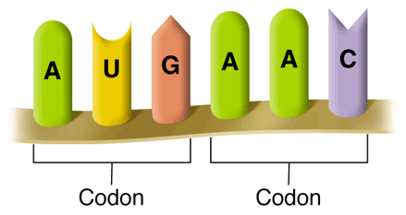
Step 2: Translation
How the code is read:
Every 3 bases on mRNA represents a code for an amino acid = codon.
Amino acids are abbreviated most times by using the first 3 letters of the amino acid’s name.
Met = methonine
Leu = leucine

Slide 17
Reading the Codon Chart
Slide # 10
Examples:
AUG = Methionine
CAU = Histidine
UAG = Stop
First Position
Third Position
Try these:
GCU:
UAC:
CUG:
UUA:
Answers:
Alanine
Tyrosine
Leucine
Leucine
This chart only works for mRNA codons.

Slide 18
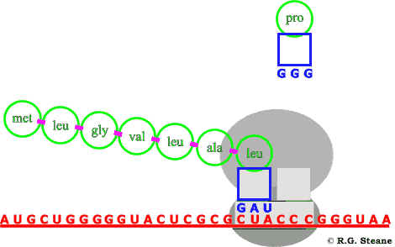
Step 2: Translation
Translation - Translating of a mRNA codons into a protein (amino acid chain)
Takes place on ribosomes in cytoplasm

Slide 19
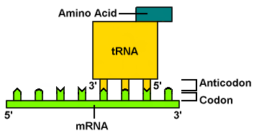
Step 2: Translation
Edited mRNA attaches to a ribosome
As each codon of the mRNA molecule moves through the ribosome, the tRNA brings the proper amino acid to the ribosome.
Notice the anticodon on tRNA – it is complementary to the mRNA codon
The amino acids are joined together by chemical bonds called peptide bonds to build an amino acid chain called a “polypeptide”

Slide 20
Regulation of Protein Synthesis
Start codons: found at the beginning of a protein
Only one - AUG (methionine)
Stop codons: found at the end of a protein (end of a polypeptide chain)
Three stop codons that do not code for any amino acid therefore making the process stop : UAA, UAG,UGA

Slide 21
Translation Animations
http://207.207.4.198/pub/flash/26/transmenu_s.swf (very good animation!)
http://www.youtube.com/watch?v=983lhh20rGY

Slide 22
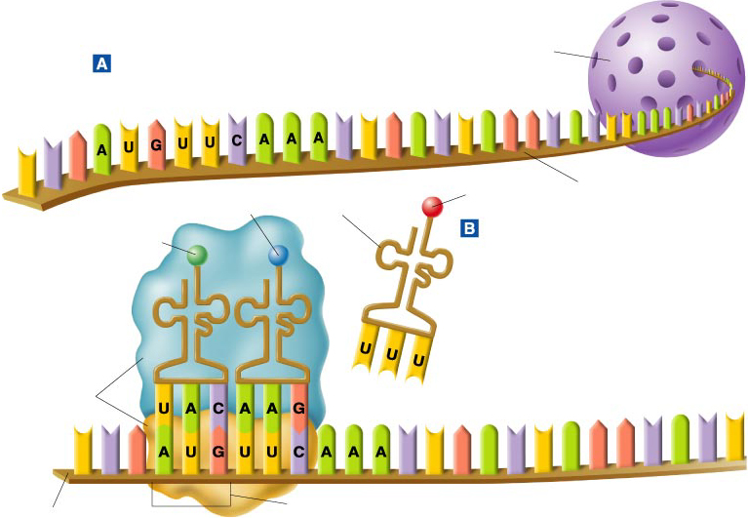
Translation
Slide # 12
Nucleus
mRNA
↓
Lysine
Phenylalanine
t RNA
Methionine
← Anticodon
Ribosome
mRNA →
Start codon
Go to Section:

Slide 23
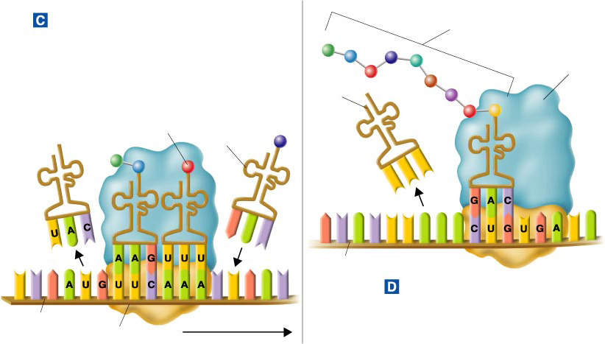
Translation
Slide # 13
Growing polypeptide chain
The Polypeptide “Assembly Line”
Ribosome
tRNA
Lysine
tRNA
mRNA
Completing the Polypeptide
mRNA
Translation direction
Ribosome
Go to Section:

Slide 24
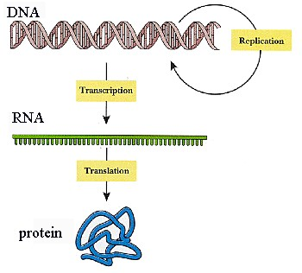

Slide 25
Roles of RNA and DNA
The cell uses the vital DNA “master plan” to prepare RNA “blueprints.”
The DNA molecule remains within the safety of the nucleus, while RNA molecules go to the protein-building sites in the cytoplasm—the ribosomes.

Slide 26
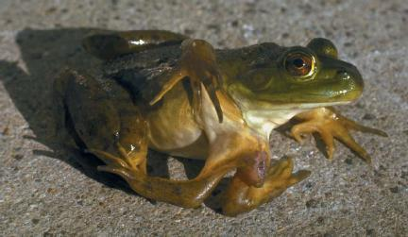
Mutations (12-4)
Mutation – changes in the genetic material (like mistakes in copying or transcribing)

Slide 27
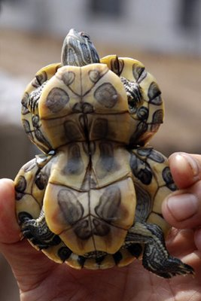
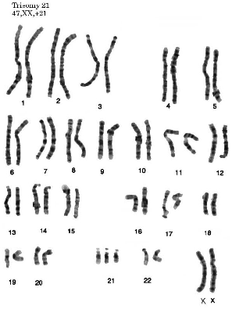
Types of Mutations
Chromosomal Mutations - Involve changes in the number or structure of chromosomes.
Ex. Downs Syndrome
Gene Mutations - Mutations that produce changes in a single gene.

Slide 28
Regulation of Protein Synthesis
Start codons: found at the beginning of a protein
Only one - AUG (methionine)
Stop codons: found at the end of a protein (end of a polypeptide chain)
Three stop codons that do not code for any amino acid therefore making the process stop : UAA, UAG,UGA

Slide 29
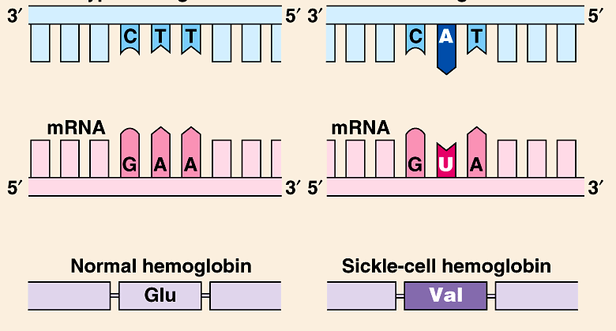
Types of Gene Mutations
Point mutations : affects single nucleotide base is replaced with the wrong base (letter)
Example: Sickle-cell anemia

Slide 30
Point Mutations: Silent
Silent mutation: a base is changed, but the new codon codes for the same amino acid. ( typically it is the third letter in the codon) Not all mutations are harmful.
Original
leading to a silent mutation
mRNA
Protein

Slide 31
Point Mutations - Substitution
Point mutation that still codes for an amino acid, just the wrong amino acid
May or may not be harmful
Original
mRNA
Protein

Slide 32
Point Mutations
Prematurely code for a stop codon
Result: a nonfunctional protein
Original
Nonsense
mRNA
Protein

Slide 33
Frameshift Mutations: Deletion
Deletion: one or more of the bases is deleted from the code
Causes a shift in the reading frame
Deletion

Slide 34
Frameshift Mutations: Insertion
Insertion: one or more base pairs are inserted into the code
Causes a shift in the reading frame
Insertion

Slide 35
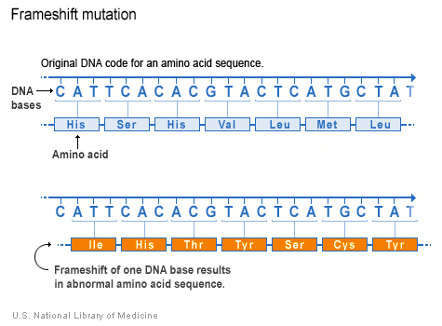

Slide 36
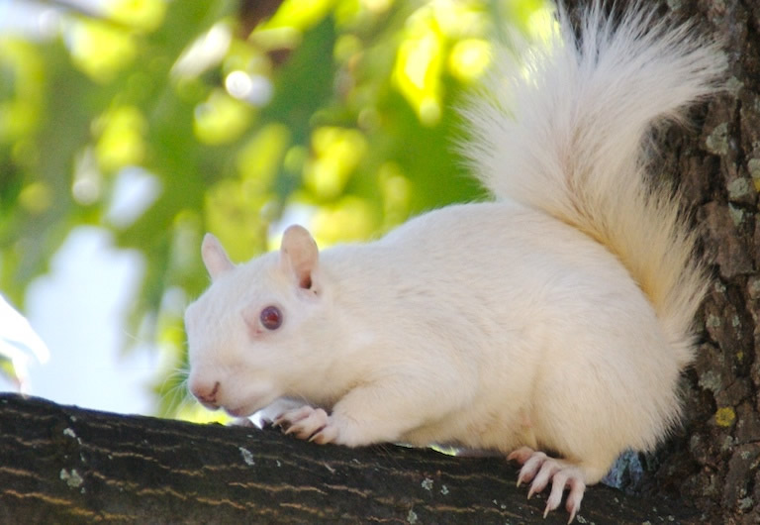
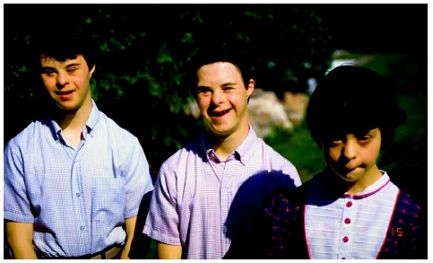
Significance of Mutations
Many mutations have little or no effect on the expression of genes.
Mutations may be harmful and may be the cause of many genetic disorders and cancer.
Source of genetic variability in a species (may be highly beneficial).

Slide 37
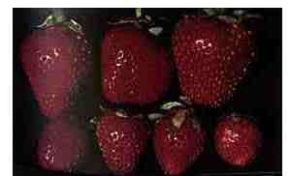
Beneficial Mutations
Beneficial mutations may produce proteins with new or altered activities that can be useful to organisms in different or changing environments.
Plant and animal breeders often take advantage of such beneficial mutations.
The condition in which an organism has extra sets of chromosomes is called polyploidy.
Often larger and stronger than diploid plants, but not beneficial in animals.

Slide 38
Gene Regulation (12-5)
Only a fraction of the genes in a cell are “expressed” at any given time
(An “expressed” gene = exons= genes that are actually transcribed into RNA)
How does the cell determine which gene will be expressed and which will remain ‘silent’?
Promoters allow RNA polymerase to bind to begin transcription. Repressors prevent RNA polymerase from binding to go through transcription.
Other DNA sequences (regulatory sites) act to turn on/off a gene

Slide 39
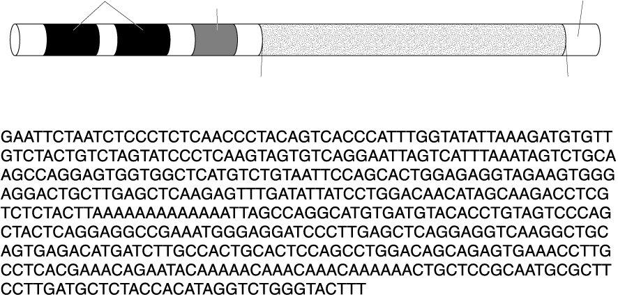
Typical Gene Structure
Section 12-5
Regulatory sites
Promoter (RNA polymerase binding site)
DNA strand
Start transcription
Stop transcription

Slide 40
Gene Regulation
The expression of genes can also be influenced by environmental factors such as temperature, light, chemicals, etc.
Notes:
When you are cold (winter) your leg hair proteins that make your hair grow are turned on

Slide 41
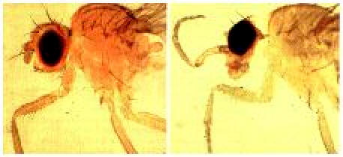
Development and Differentiation
Regulation of gene expression is important in shaping the way an organism develops, shaping the way cells undergo differentiation, by controlling which genes are expressed and which are repressed.
A series of genes call Hox Genes control the differentiation of cells in the embryo.
Notes:
A mutation in one of these genes can completely change that organisms development.
Ex- A mutation in the Hox genes of a fruit fly can replace antennae with legs growing on its head.

Slide 42
Gene Regulation (12-5)
A. Not all genes are active (expressed) at the same time.
1. Why: Because the cell would produce many molecules it did NOT need – waste of energy and raw materials
2. Gene expression (protein synthesis) is when the product of a gene (specific protein) is being actively produced by a cell.
a. some genes are – rarely expressed -- adrenaline
b. some genes are – constantly expressed – hair growth, blood pressure
c. some genes are – expressed for a time, then turned off (cyclical) -- estrogen

Slide 43
